Slide 1
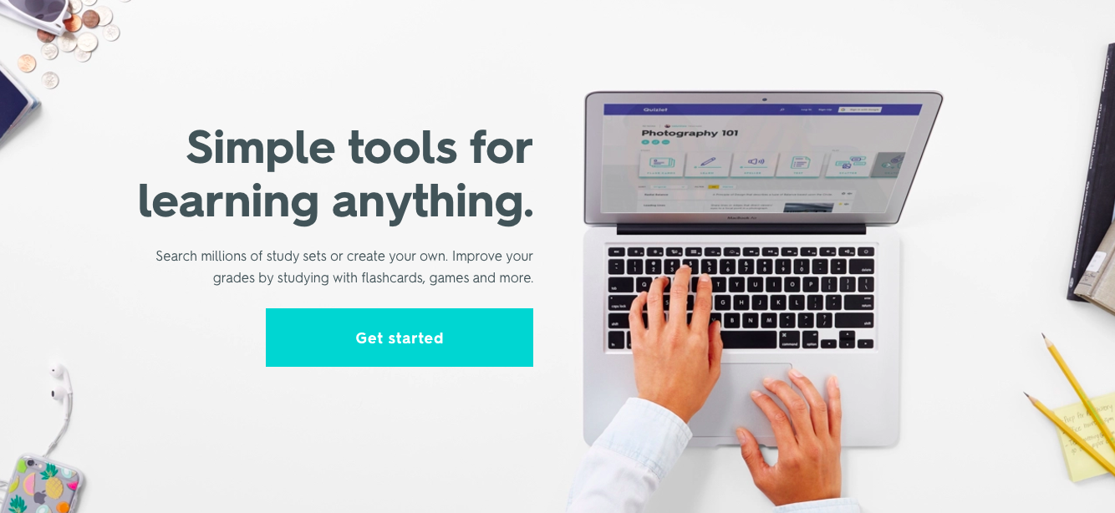
Getting Started with Quizlet A Presentation for Teachers
Notes:
Use this presentation as is or customize your copy. If you’re doing an interactive or in-person workshop, ask your attendees to sign up for a free account before the event.

Slide 2
Presentation Agenda
Why use Quizlet?
Engaging study activities (that work!)
Quizlet Live: Building soft skills with review
Use material created by other teachers
Create your own custom material
Set up classes and track student progress
Getting started on Quizlet
Signing up for an account
Quizlet Teacher upgrade options
Video overviews
More resources

Slide 3
Why use Quizlet?
Quizlet is an effective way to get your students engaged with the material being taught in class, and can be used in and out of the classroom.
Students love it
90% of learners say Quizlet motivates them more; 95% feel it improves their grades.
Free and easy to use
Signing up takes 30 seconds. Find existing study content or create your own easily.
Choose what works
Interactive material + eight learning activities and games support and engage all students.
Manage your classes
Create up to 8 classes for free, or upgrade to create unlimited and track student progress.
Notes:
Feel free to customize this slide to highlight aspects of Quizlet that you find most appealing or helpful.

Slide 4
Engaging study activities (that work)
Quizlet offers several different learning activities that students can use based on what works for them, and that allow them to study at their own pace.
Independent study activities
Timed games with a group leaderboard
An adaptive study plan
Practice tests

Slide 5
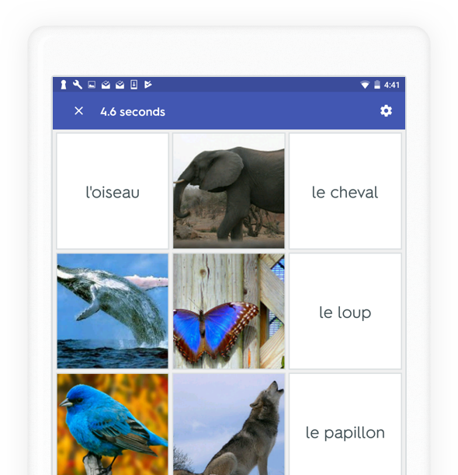
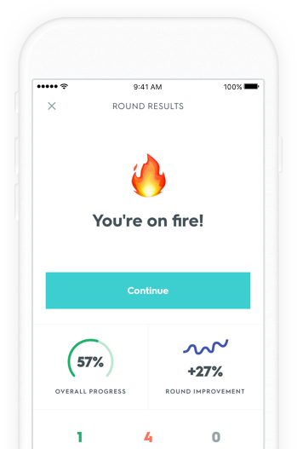
Engaging study activities (that work)
Students can use the activities in or outside of class, collaboratively or individually.
Quizlet’s free mobile apps allow them to study anytime, anywhere!
Notes:
Learn more: https://quizlet.com/mobile

Slide 6
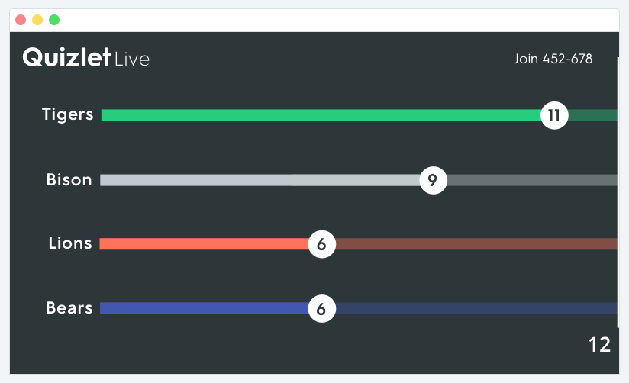
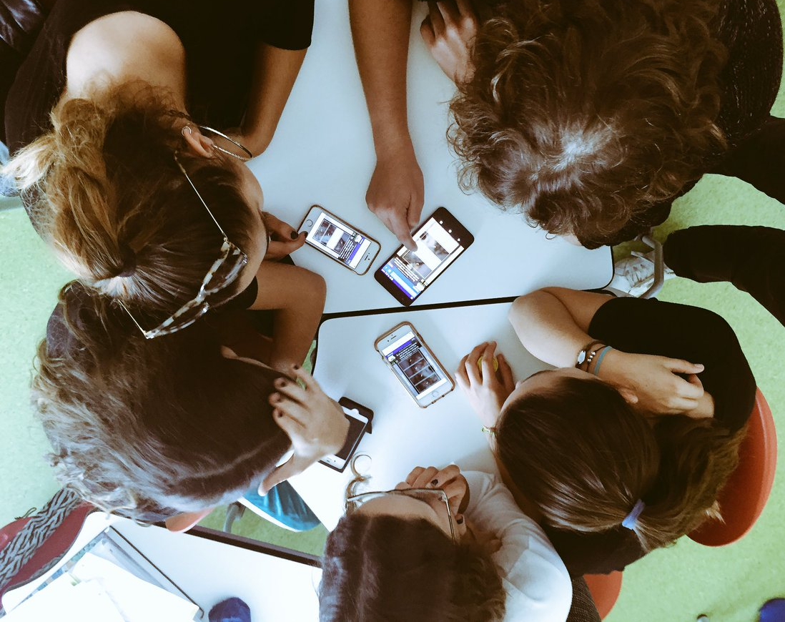
Quizlet Live: Building soft skills with review
Quizlet Live, Quizlet’s collaborative in-class game, not only reinforces the material taught in class, but promotes communication skills between students. (And it’s really fun!)
Students must work together to win!
Notes:
Quizlet Live is available for all teachers with free Quizlet accounts. When logged in, they will see the “Live” button on every set page. If a teacher doesn’t see the “Live” button, have then check that their account is registered as a teacher in their settings: quizlet.com/settings

Slide 7
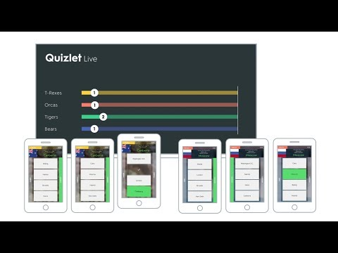
Quizlet Live: How to play
When you’re in class:
Go to a study set with 6 or more terms and definitions
Click the “Live” button and choose how to play
Project your screen to the class and ask students to go to www.quizlet.live
They will enter the game code on their individual devices
Click “Create game” to group students into teams
Start the game!
Notes:
For an interactive workshop, launch a game of Quizlet Live for your attendees to play. Use a relatively easy set, like U.S. state capitals or superheroes. Or create a custom set with faculty names and faces, or school trivia. If you’re not able to play, watch our 2-minute demo video.

Slide 8
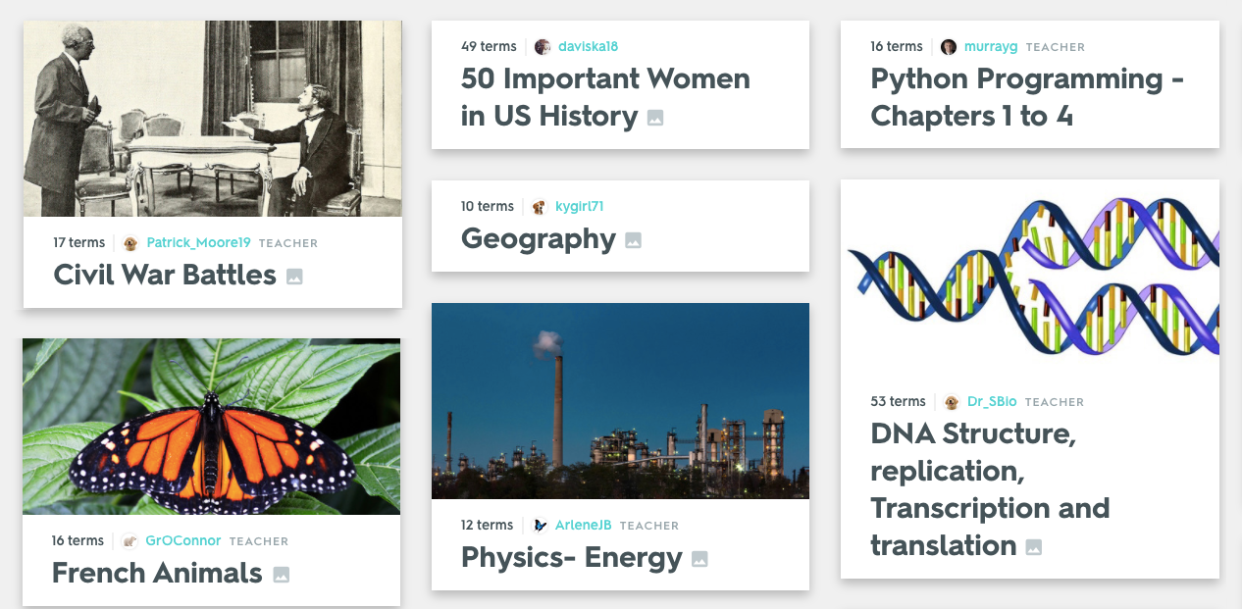
Use material created by other teachers
Quizlet works for any subject. Over 250 million sets on thousands of topics have already been created by other teachers and students — and are free to use.

Slide 9
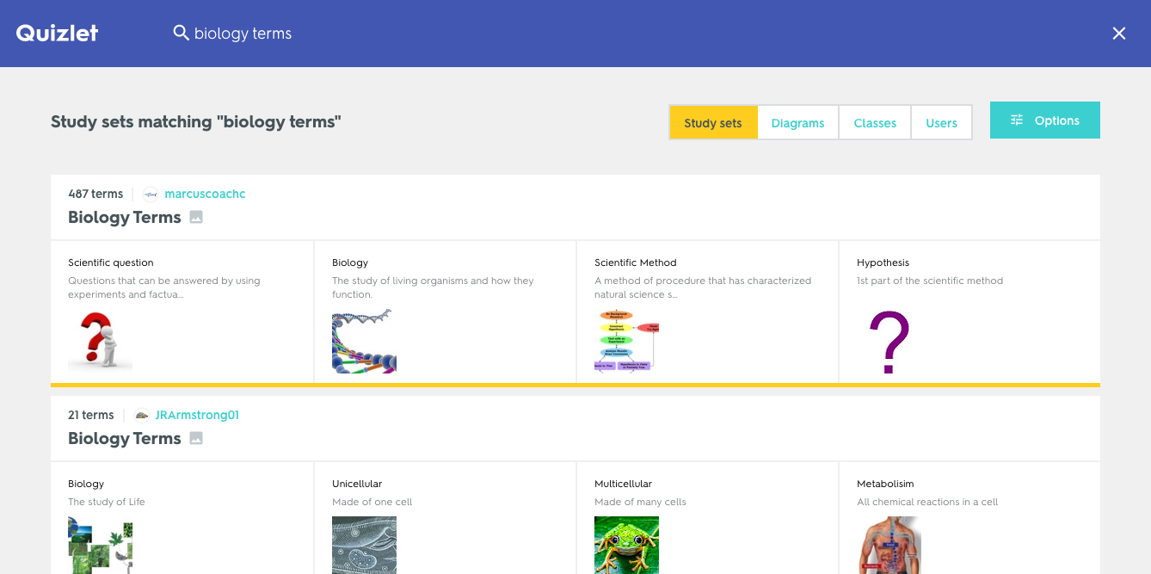
Use material created by other teachers
Teachers can save time by searching for existing content to share with their students or play Quizlet Live with.
Search by:
Subject
Keywords
Book title
Filter by:
Sets, diagrams, classes, users, with images, Teacher-created
Notes:
If you’re leading an interactive, in-person workshop, ask teachers to try searching for a topic (the more specific their keywords, the better). Then have them click into a set and explore the study activities and games for 5-10 minutes.

Slide 10
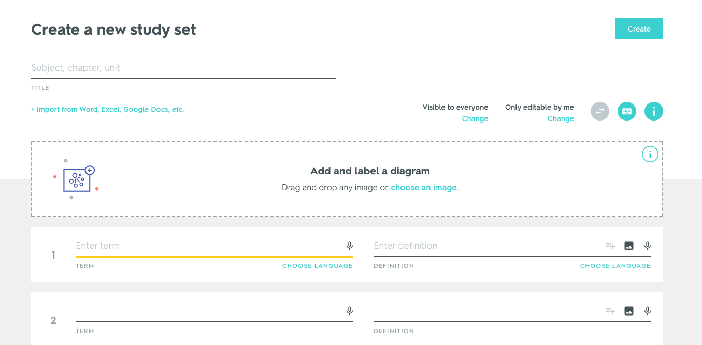
Create your own custom material
Teachers (and students) can also create their own material to use.
Creating engaging content is easy; Quizlet sets can be used year after year and edited at anytime. There is no limit on the number of sets you can create.
Choose privacy permissions
Import material
Auto-define terms, add images or audio
Label a diagram
Select a language for each side
Notes:
Use this time to review a few key areas and capabilities of the Create Set page, like the ability to import material, using auto-define, adding images, selecting languages, creating a diagram set, and privacy permission.

Slide 11
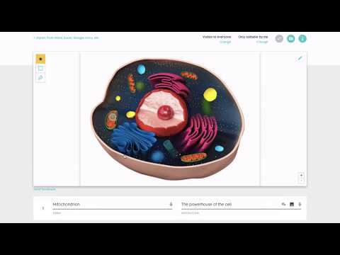
Quizlet Diagrams
Creating a diagram set enables students to practice their visual material in engaging and effective ways. Think maps, charts, anatomical illustrations and more.
Learn more about Diagrams:
quizlet.com/features/diagrams
Notes:
If you’re leading an interactive session, have teachers create a diagram set by finding an image, uploading it, and labeling key areas with points, terms and definitions. Show them how to edit the uploaded image and use the blur tool. Have them save their set and explore the activities available on a diagram. Learn more: https://quizlet.com/help/2861760/creating-a-diagram-set

Slide 12
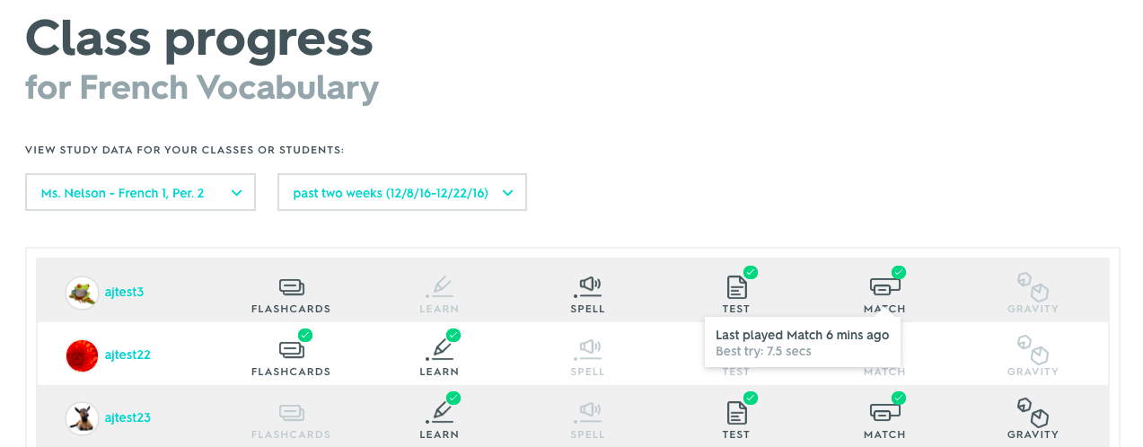
Set up classes and track student progress
Teachers can set up classes on Quizlet to easily share material with their students and track their activity and progress.
Organize your material and students in classes
View class study activity and progress
Notes:
Classes enable Class Progress, a paid feature of Quizlet Teacher, to work. If you have a paid account, highlight group progress view on the set page as well as individual activity on the Class Progress page. Learn more here: https://quizlet.com/help/2444133/see-class-progress-with-teacher-view

Slide 13
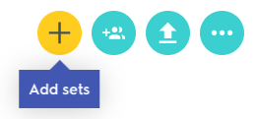
Creating a Quizlet class
Choose the option to “Create a class” on the sidebar
Add any relevant sets to your class
Find the unique join link on the page and share it with your students
Notes:
If you’re leading an interactive, in-person session, have attendees create a class and add a set to it (the one they previously created). Then point out the join link, as the easiest way to get students into classes. Free accounts can create up to 8 classes. You can also give them this handout to share with their students, which covers how to sign up and join their class: https://cloudup.com/cJEb1xgRz-V (for students 13 and over) and (https://cloudup.com/cnXe8j3xHJA (for students 12 and under)

Slide 14
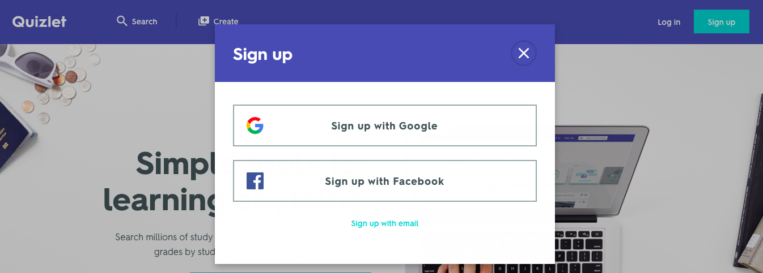
Getting started on Quizlet
If you haven’t already, sign up for an account:
Go to the Quizlet website: https://quizlet.com/
Choose to sign up with Google, Facebook or your email address
Continue with a free account or upgrade to Quizlet Teacher
Notes:
If you’ve just reviewed the previous slides, have teachers sign up for an account at this point. If they’ve already sign up before the session, consider removing this slide (or moving it to the start of the presentation).

Slide 15
More features with Quizlet Teacher
Quizlet Teacher is only $35.99/year and gives you more powerful features:
Class Progress
View student study activity and track their progress.
Image Uploading
Customize your sets with your own images.
Advanced diagrams
Unlimited locations, custom shapes and copy.
Voice Recording
Add custom audio (your accent, slower audio, etc).
Quizlet Live Add-ons
Create your own teams, add audio, play on Diagrams.
No Ads on Sets
You and your students won’t see ads on your sets.
Learn more: http://bit.ly/QuizletTeacherUpgrade

Slide 16
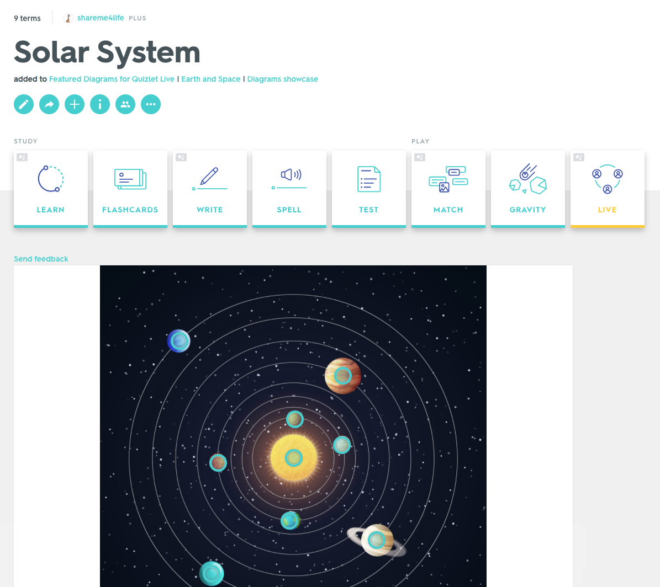
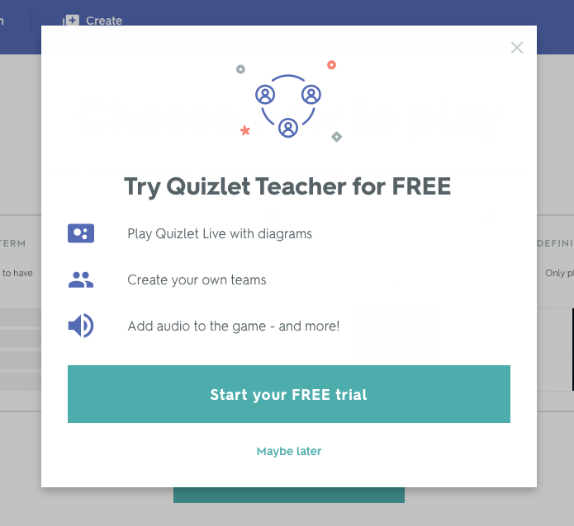
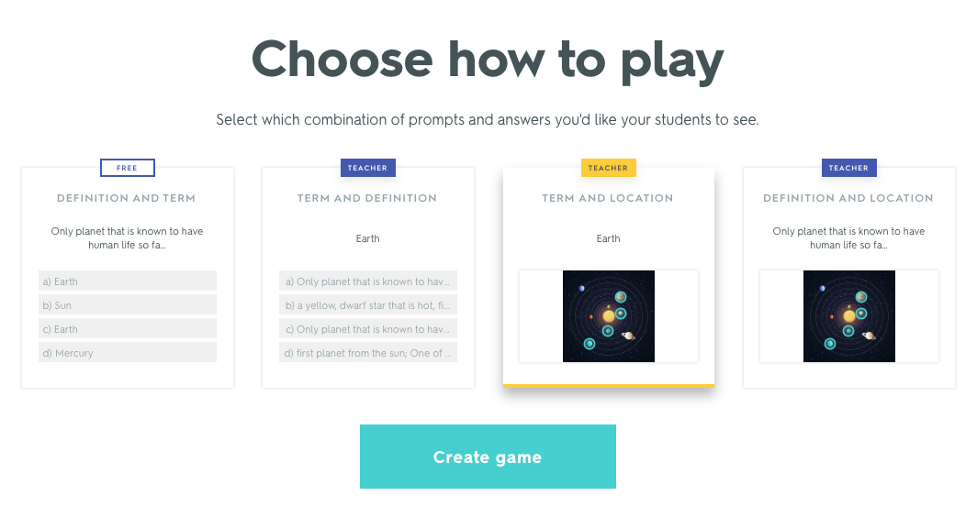
Launch a 2 week free trial of Quizlet Teacher
1
You can still play with Quizlet Live’s free option when your trial ends
3
2
Notes:
Play Quizlet Live on a diagram set to unlock a 2 week free trial of Quizlet Teacher. You’ll have access to all paid features (including more ways to customize Quizlet Live) for that time period!

Slide 17
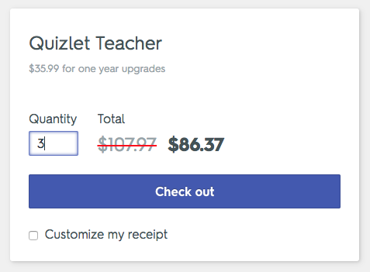
Discounts for schools and groups
Save 20-25% by purchasing Quizlet Teacher upgrades for your group:
Enter the quantity (2 or more)
Check out and pay, or generate an invoice
Receive one upgrade link by email
Share this link with your group
When they follow this link, a one-year upgrade will be activated on their account or added to their current subscription
Learn more and see discounts: http://bit.ly/GroupUpgrades
Notes:
If presenting to technology decision-makers, note that purchasing as a group consolidates the upgrade process for individual accounts. Instead of waiting for each teacher’s current subscription to expire and renewing one-off, school admins can make one purchase at the start of the year that covers all accounts. Additionally, generating an invoice allows someone else to complete the purchase by credit card or check.

Slide 18
How to use Quizlet video overview
Educator Jennifer Gonzalez goes over how to create a set and use study modes:
Notes:
If you’re not leading an interactive workshop, watch these videos together (or just share them as more resources) to see Quizlet in action.

Slide 19
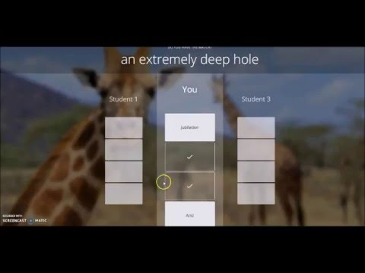
Playing Quizlet Live video overview
Educator Carissa Peck takes us through what students see when playing Quizlet Live:
Learn more about Quizlet Live:
quizlet.com/features/live

Slide 20
More teacher resources
For Teachers: quizlet.com/teachers
Quizlet Help Center: quizlet.com/help
Blog: quizlet.com/blog
Facebook: facebook.com/quizlet
Twitter: twitter.com/quizlet
Notes:
Our For Teachers page has links to new webinars, PD resources, and Quizlet’s blog with ideas from our teacher community. The Help Center has step-by-step instructions on all core functionalities of Quizlet. Follow Quizlet on Facebook and Twitter to stay up to date on new product news and teacher opportunities.

